Slide 1
Welcome to Robot Programming!
CS Basics Lesson 1

Slide 2
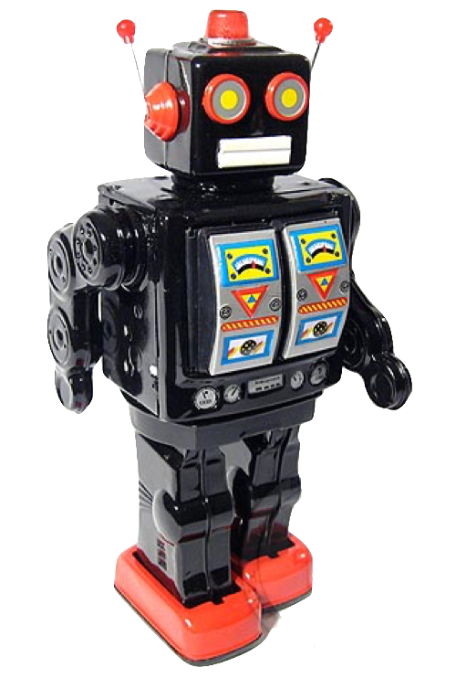
“Robots only do what you tell them to”
robot – machine which performs difficult tasks on command
program – set of instructions
programmer – person who writes the robot’s instructions

Slide 3
PB&J Robot
Robot Instructions
Human Instructions

